Slide 1
Keep Kubernetes Simple and Fun
阿里云容器服务团队 张维
Kubecon shanghai 2018

Slide 2
Why Kubernetes?
One of the largest open source projects in the world
One of the most popular technologies in the world
Self driven by Kubernetes community
The industry standard for deploying containers in production

Slide 3
Why Kubernetes?
One of the largest open source projects in the world
One of the most popular technologies in the world
Self driven by Kubernetes community
The industry standard for deploying containers in production
Developers love it

Slide 4
But Kubernetes is still hard to start
Cluster provisioning
Complexity
Configuration
Capacity planning
Cost
…

Slide 5
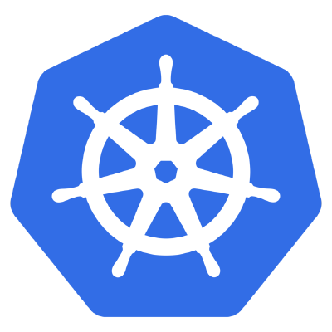
Why Kubernetes in the Cloud?
敏捷 Agility
安全 Security
弹性 Scalability
集成 Integration
成本优化 Cost optimization
多种部署形态
专属版 Dedicated
托管版 Managed
无服务器版 Serverless

Slide 6
Dedicated Kubernetes vs. Managed Kubernetes
Dedicated Kubernetes Cluster
- Master节点的成本和运维操作都要用户承担
Managed Kubernetes Cluster
- 只需要承担Worker节点成本
- Master由容器服务自动运维
User Resources
Service Resources
Master
Master
Master
Managed
Managed
APIServer
APIServer
APIServer
APIServer
APIServer
User Resources
Worker
Worker
Worker
Worker
Pod
Pod
Pod
Pod
Pod
Pod
Pod
Pod

Slide 7
Scaling Kubernetes Elastically

Slide 8
Demo: Managed Kubernetes + Serverless addon
容器调度与编排
Node-1
Node-2
Node-N
Virtual Node
Pod
Pod
Pod
Pod
Pod
Pod
ECI Provider
无限弹性，敏捷扩容
按需付费，灵活创建
支持pod之间互联互通
Pod
Pod
Pod
…
Elastic Container Instance (ECI)

Slide 9
More about Serverless
Managed Kubernetes
- 按照集群Worker节点数量付费
Serverless Kubernetes
- 按照应用使用资源付费
无需管理服务器节点
无需节点容量规划
容器调度与编排 - 托管Masters
容器调度与编排
Managed Kubernetes集群
Serverless Kubernetes集群
ECS
ECS
ECS
Pod
Pod
Pod
Pod
Pod
Pod
Pod
Pod
Pod
Pod
Pod
Pod
Pod
Pod
Pod
Pod
Pod
Pod
Pod
Pod
Pod
Pod
Pod
Pod

Slide 10
Get Started with Kubernetes on Alibaba Cloud
Console：https://cs.console.aliyun.com
Deploy Serverless Addon to scale your cluster：
https://yq.aliyun.com/articles/647119?spm=a2c4e.11155435.0.0.23773312J8KlR7

